Slide 1
Football Pitches Booking
GROUP 10

Slide 2
TEAM MEMBERS
Supervisor: Lại Đức Hùng
Nguyễn Quốc Khánh
Nguyễn Đức Thịnh
Nguyễn Hữu Hoàng Giang
Nguyễn Duy Phương

Slide 3
OUTLINE
Actual research
Advantages & disadvantages of current system
Propose solution
Demonstration
Advantages & disadvantages of new system
Future plan
Technology & development environment

Slide 4
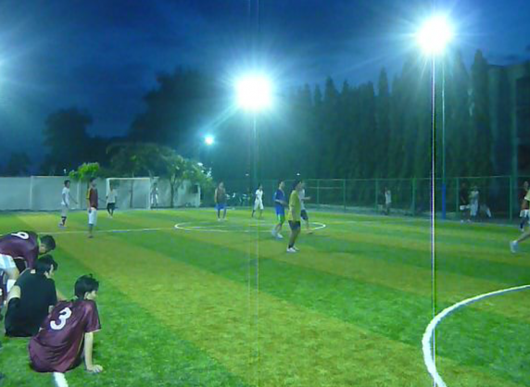
Actual research
The need of strength practice in limited time

Slide 5
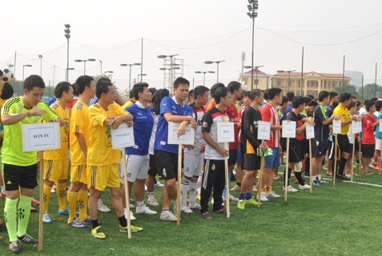
Actual research
Appearance of spontaneous football games

Slide 6
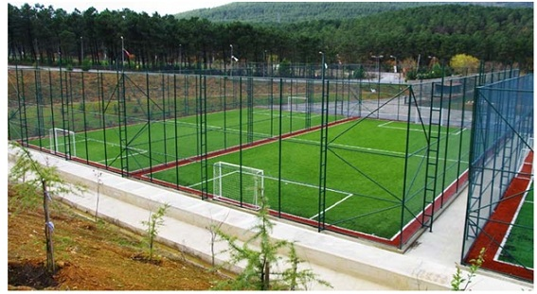
Actual research
Fast increase of artificial grass field

Slide 7
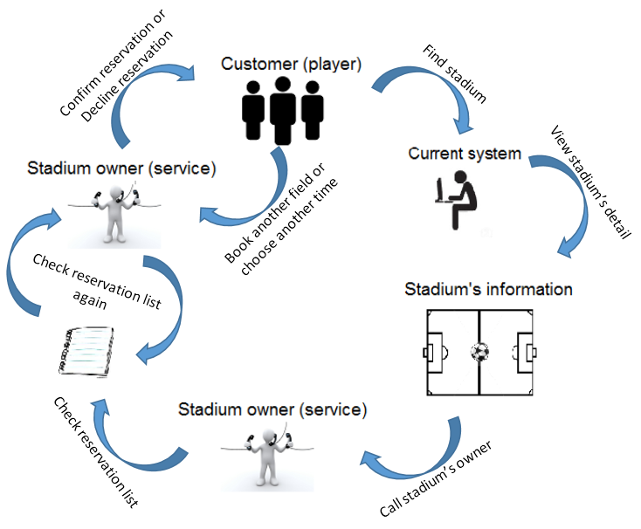
The traditional booking process

Slide 8




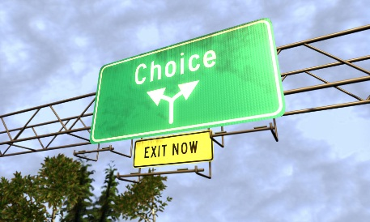
Current systems
Advantages Disadvantages
Time-consuming
Complicated process
Ineffective management
Limited choices

Slide 9
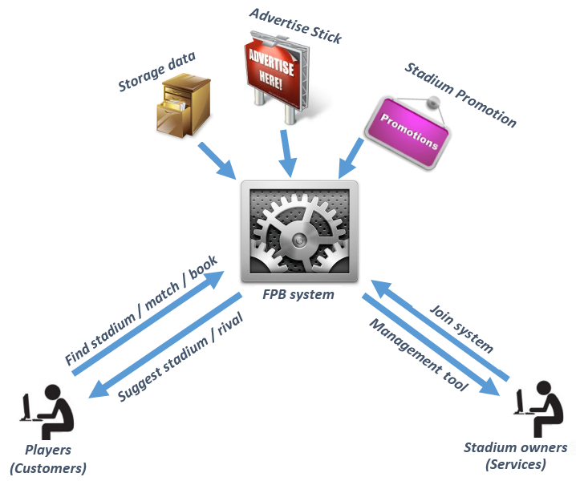
Football Pitches Booking

Slide 10
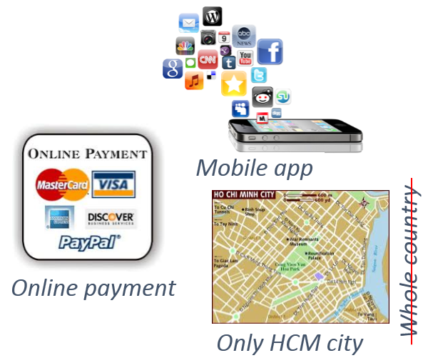
Football pitches booking
Advantages
Disadvantages
More stadium choices
Easy finding stadium/rival
Easy booking
Time saving when finding appropriated field
Connecting players
Easy management
More chance to promote and advertise
Not support yet

Slide 11






TECHNOLOGY & DEVELOPMENT ENVIRONMENT

Slide 12
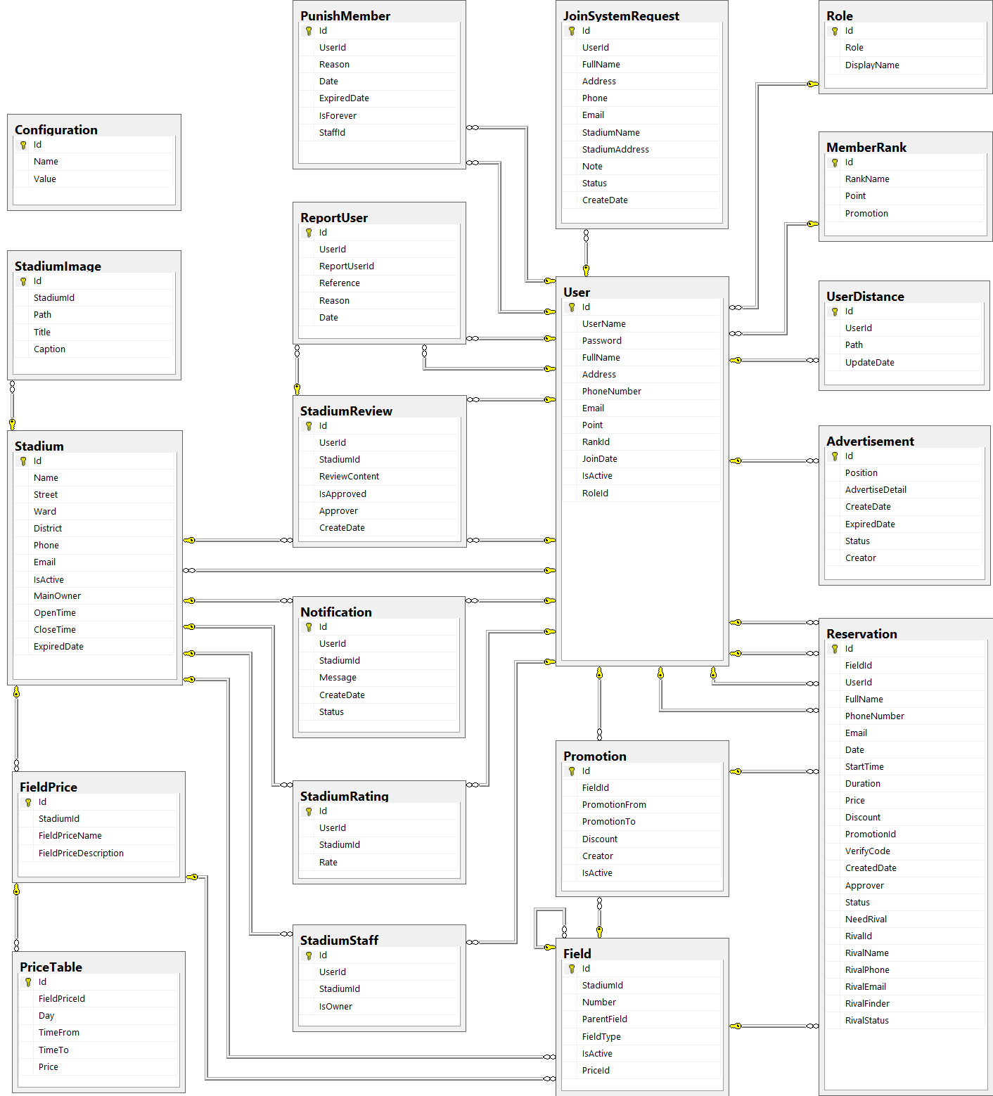
Database Design

Slide 13
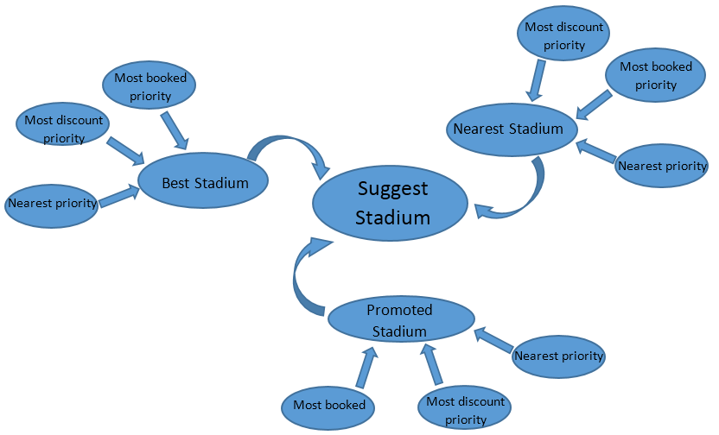
Business Intelligence

Slide 14



FUTURE PLAN
Upgrade system to operate in whole country
Support online payment
Develop mobile apps on another platform: iOS, Windows Phone, Android

Slide 15
Thanks for watching Q&A

